Slide 1
Development of an Electrical Measurement setup for the characterization of Quartz tuning forks
Sathyajith Shanthkumar
Matr Nu: 65442
Supervised by Busra Oyku Alan, Johannes Torben Bruno Krech

Slide 2

Contents
Introduction
Scanning Probe Microscopy
LabVIEW VI’s and data transfer
Tuning Fork and its Properties
Results and Optimization
Conclusion
Experimental Setup

Slide 3
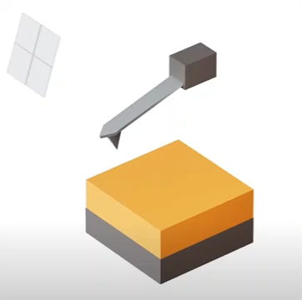
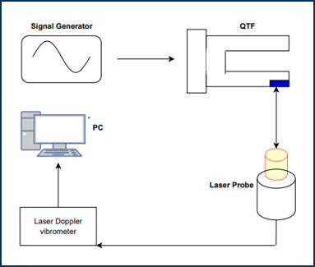
Working Principle: Scanning Probe Microscopy
Non-Contact Mode

Slide 4
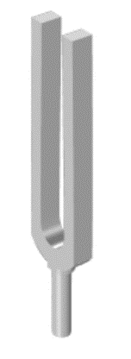
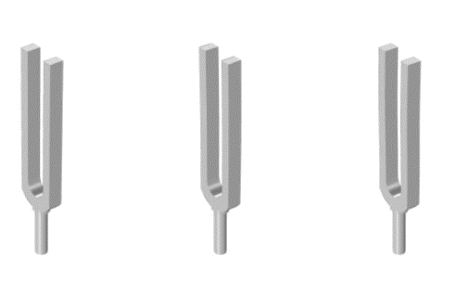
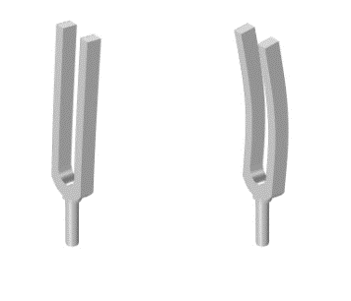
Tuning Forks
Invented in 1711 by John Share
Mechanical Oscillator
Quartz tuning fork: High Quality factor
Possess many types of oscillation:
Fundamental and asymmetric
In-phase
In-plane and Out of plane

Slide 5
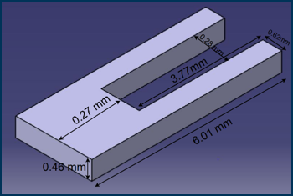
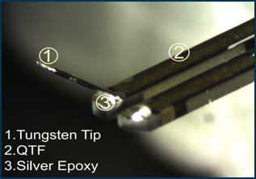
Quartz Tuning Forks:
2 prongs attached to a base
QTF is mostly used in Non-contact modes
Tungsten tip attached to a QTF using silver epoxy
An additional mass of 0.33 milligrams is added to the tuning fork

Slide 6
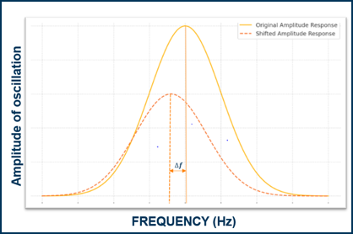
Problem Description
Tuning forks are used for scanning probe microscopy.
Adding masses to a tuning fork reduces its amplitude and resonant frequency.
This experiment verifies the frequency shift.
LabView generates an actuation signal, and the amplitude is recorded, converted to voltage, stored in Excel, and plotted in MATLAB.

Slide 7
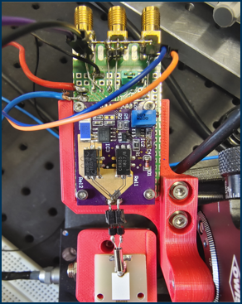
Experimental Setup
Components used:
FPGA Board – USB 7856 OEM
Host Computer (Windows OS)
LabVIEW Version 2022 Q3 (64 Bit)
Keysight oscilloscope (InfiniiVision DSOX2014A)
Resistors
Operational Amplifier: Amplifie Voltcraft VSP 2405 HE

Slide 8
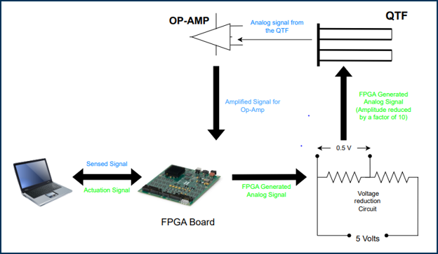
Electrical Setup

Slide 9
Pre-requisites
Evaluate System Requirements
Create FPGA VI
Select Architecture
Create Host VI
Simulate on PC
Configure Hardware
Compile to FPGA
Create LabVIEW Project
Run Program

Slide 10
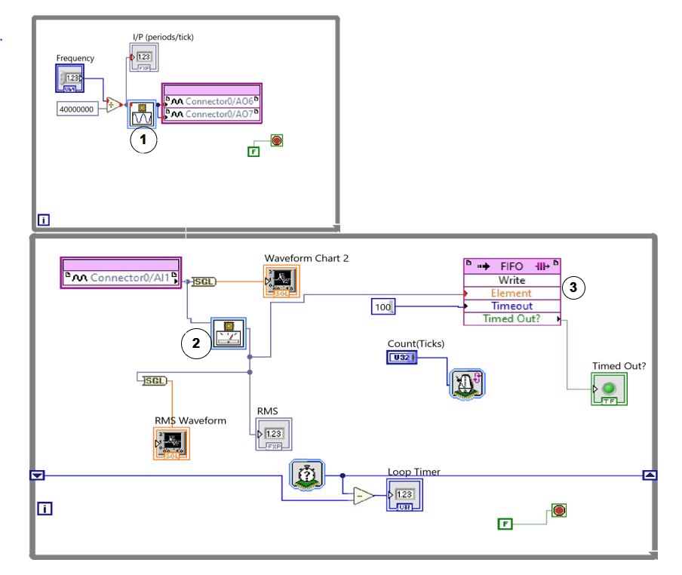
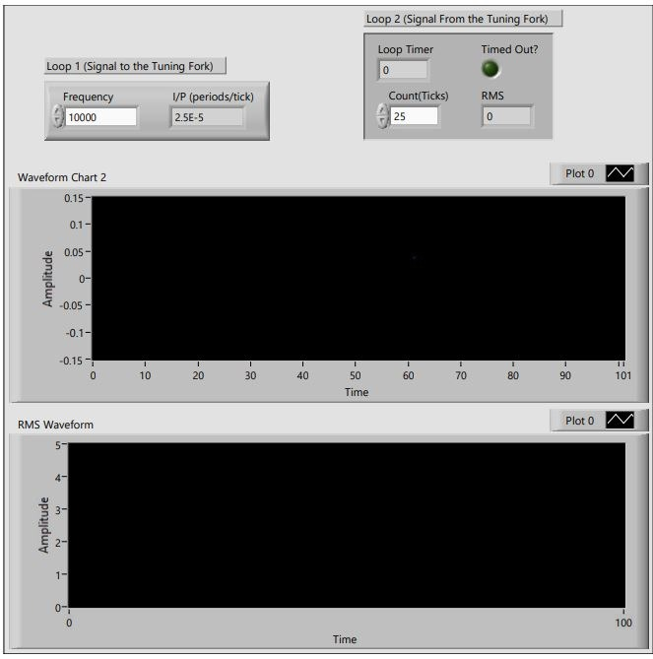
FPGA VI

Slide 11
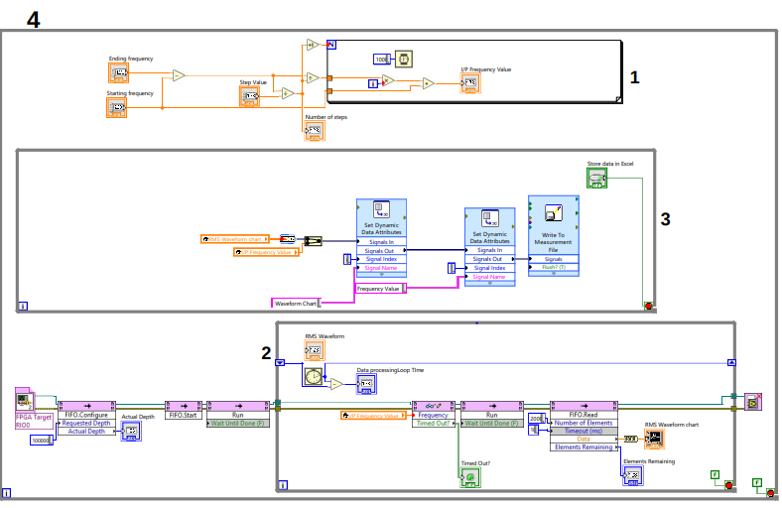
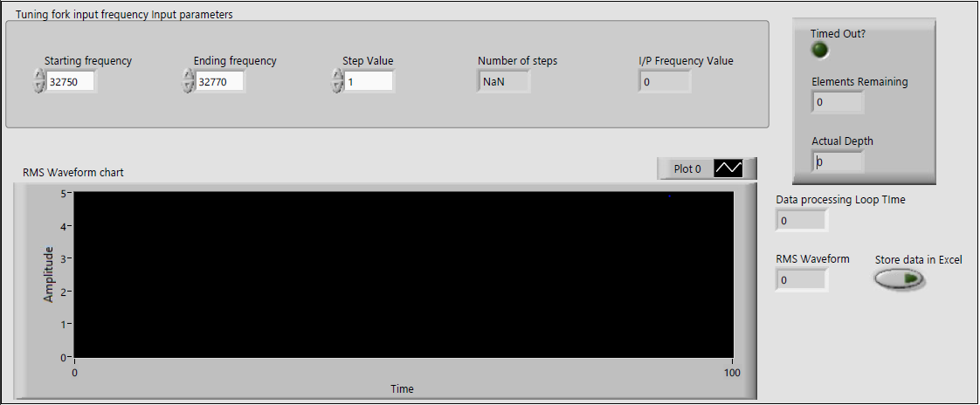
HOST VI

Slide 12
Loop 1: Data transfer
Loop 3
Individual frequency value to the Data storage VI
Loop 1
Enter Start Frequency
End Frequency
Step Value
Step Value Frequency
Loop 2
Individual frequency value to the FPGA VI

Slide 13
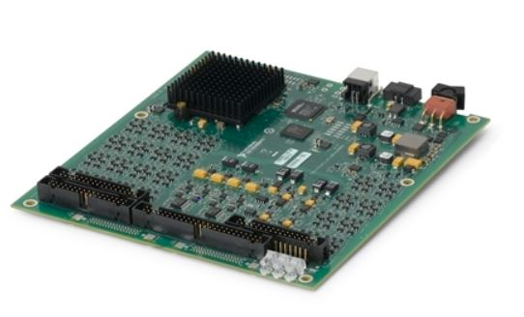
Inter-loop and FPGA Data transfer
Loop 3
Time Out information
Sensor information
FPGA info
Loop 2
Refer to FPGA VI
Configure FIFO
Send and receive Data from FPGA
Host
FIFO Configuration information
Frequency Values
Frequency values
Loop 1

Slide 14
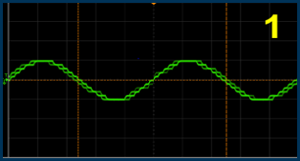
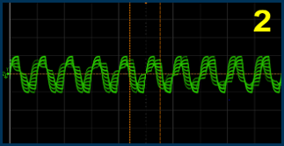
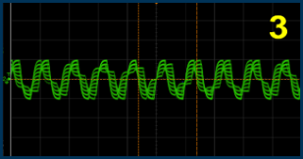
Signals generated from the FPGA board as seen on the oscilloscope:
30000 Hz
50000 Hz
90000 Hz
An increase in signal distortion with increasing frequency is visible
Possible Reasons:
Hardware Limitations
Look up table limitations, high-frequency Harmonics

Slide 15
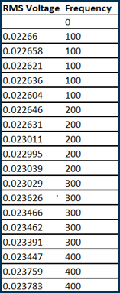
Data recorded from the Loop 3 of the PC VI:
Recorded data indicated the fluctuation in RMS Voltage
Frequency value remains the same
To plot the graph, the average of the RMS Voltage is plotted against the frequency value
Deviation of the RMS voltage is in the range of 0.01 to 0.0001 Volts

Slide 16
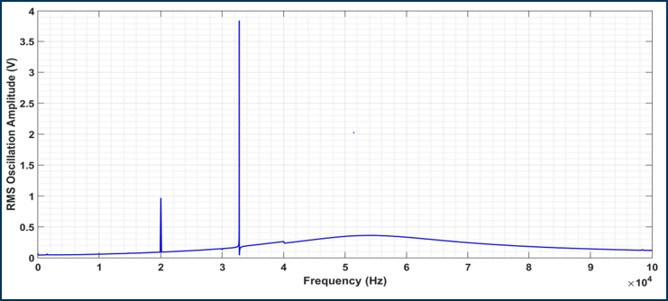
Results: QTF in Vacuum
Highest oscillation amplitude of all the variations
Low Coupling of the Input and output signal

Slide 17
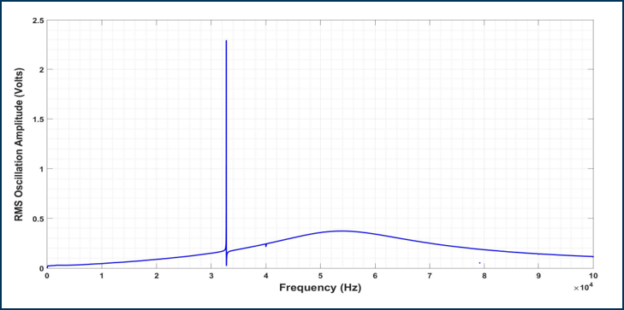
Result: QTF in Atmosphere
Significant decrease in amplitude
Coupling of the Input and output signal

Slide 18
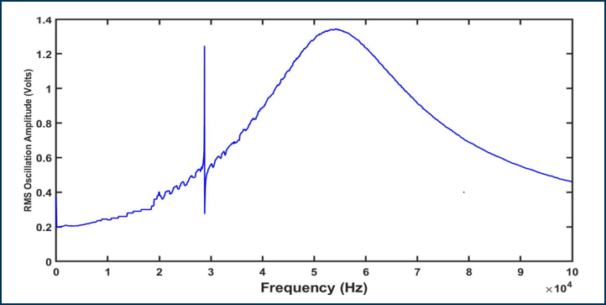
Result: QTF with a tungsten tip attached
Least Oscillation amplitude
Highest coupling of the Input and output signal

Slide 19
Circuit and setup optimization
Data analysis: Loop rates vary. Solution: Implement Producer-Consumer architecture in LabVIEW for wider frequency scans at faster speeds.
Improve signal integrity: Use more powerful hardware with faster signal generation.
LabVIEW VI optimization: Utilize function generators and high-frequency analog signal modules for better accuracy.

Slide 20
Conclusion
Electrical Setup: This setup analyzes and automates the actuation of a QTF across a range of frequencies.
Resonant Frequency Analysis: The resonant frequency of three QTF variations is demonstrated.
Challenges: Errors and signal integrity issues are discussed.
Improving Accuracy: Techniques for enhancing result accuracy are explored.

Slide 21


